Slide 1
Data Analysis for Online Retail Store

Slide 2
Agenda
Project Recap
Objectives
Process
Insights
Implications

Slide 3
Project Recap
"We've conducted a comprehensive analysis of your online retail store's data to provide actionable insights for strategic planning. Over the past year, your business has shown robust performance with notable trends in revenue growth and customer engagement. Our analysis pinpointed key contributing factors to revenue. Operational metrics revealed opportunities for streamlining processes, while demographic-based insights shed light on customer preferences and regional potential for expansion. Moving forward, our recommendations focus on leveraging these insights to optimize marketing strategies, enhance operational efficiency, and capitalize on growth opportunities in targeted markets."

Slide 4
Objectives
Customer Insights: Leveraging demographic data more effectively to understand customer behavior and preferences can lead to more targeted marketing campaigns and personalized customer experiences, thereby increasing loyalty and engagement.
Strategic Expansion: Identifying and capitalizing on growth opportunities in specific geographical regions or market segments based on comprehensive data analysis will be essential for future expansion and market penetration.
Revenue: Identifying the revenue by month, which month generates the highest revenue.
Customers retention: Identifying the customers who have the most repeated orders

Slide 5
Process
Data Understanding
Data Cleaning
Data Modeling
Data Analysis
Data Visualization

Slide 6
Insights
$ 9.84 M
November
Netherlands
14646
November month have generated the highest revenue
Maximum number of revenue is generated from Country Netherlands
Customer having customer Id 14646 having the most orders
Overall Revenue of The online retail store is of 9.84M Dollars

Slide 7
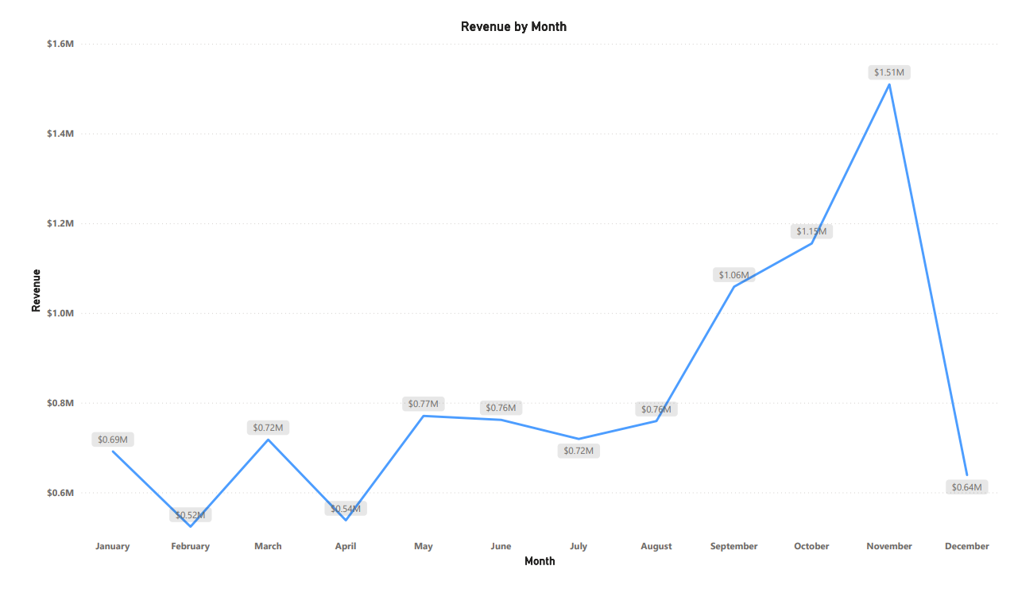
Monthly Revenue
The provided line graph illustrates the monthly revenue trends from January to December. The year began with moderate revenue of $0.69M in January, followed by a notable dip to $0.52M in February. March saw a recovery with revenue increasing to $0.72M, but April experienced another dip to $0.54M. From May onwards, the revenue exhibited a generally upward trend with minor fluctuations, achieving $0.77M in May and stabilizing around $0.76M in June. The trend remained relatively steady through July and August with slight dips and rises. A significant increase began in September, where the revenue rose to $1.06M, followed by further growth in October and November, peaking at $1.51M. However, December saw a sharp decline to $0.64M. This pattern indicates strong seasonal effects and potentially impactful factors influencing revenue, particularly in the last quarter of the year.

Slide 8
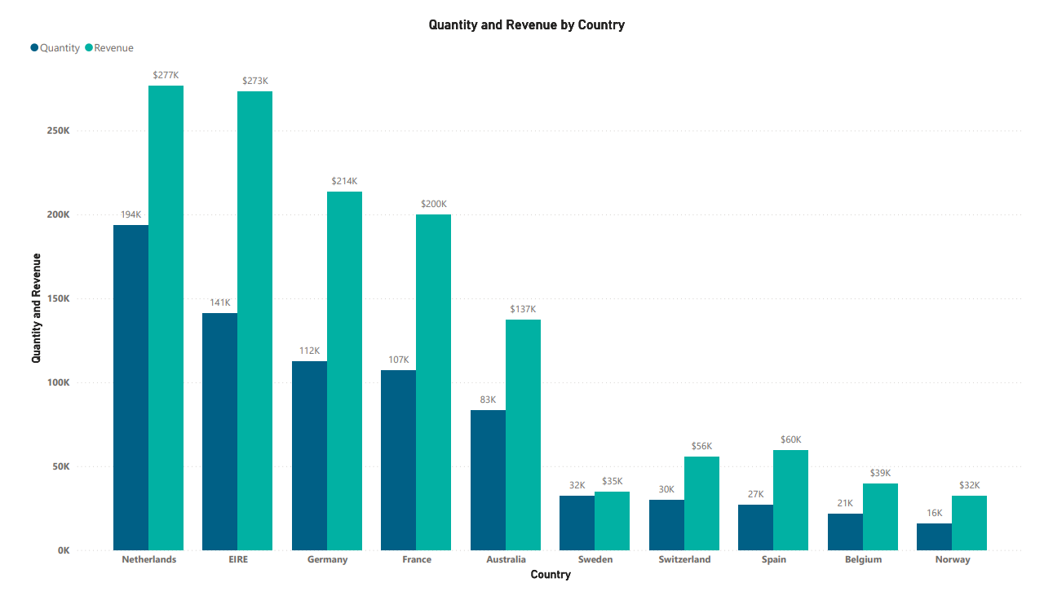
Quantity and revenue by country
The graph highlights both the quantity of products sold and the revenue generated by country, with the Netherlands leading in both quantity (194K units) and revenue ($277K). EIRE shows high revenue ($273K) despite lower quantities (141K units), indicating high-value purchases. Germany, France, and Australia also emerge as significant markets. Smaller markets like Sweden, Switzerland, Spain, Belgium, and Norway, while generating lower quantities, still contribute notable revenue. The graph highlights both the quantity of products sold and the revenue generated by country, with the Netherlands leading in both quantity (194K units) and revenue ($277K). EIRE shows high revenue ($273K) despite lower quantities (141K units), indicating high-value purchases. Germany, France, and Australia also emerge as significant markets. Smaller markets like Sweden, Switzerland, Spain, Belgium, and Norway, while generating lower quantities, still contribute notable revenue.

Slide 9
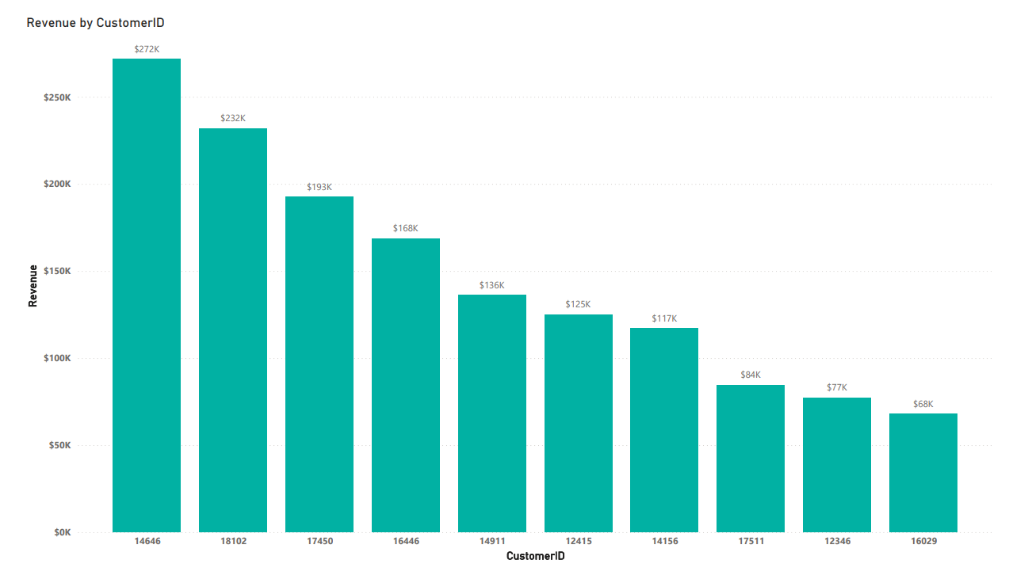
Top Customers By Revenue
The bar graph illustrates the top customers by revenue, with Customer 14646 generating the highest revenue at $272K, followed by Customer 18102 at $232K and Customer 17450 at $193K. Other notable customers contribute revenues ranging from $68K to $168K.

Slide 10
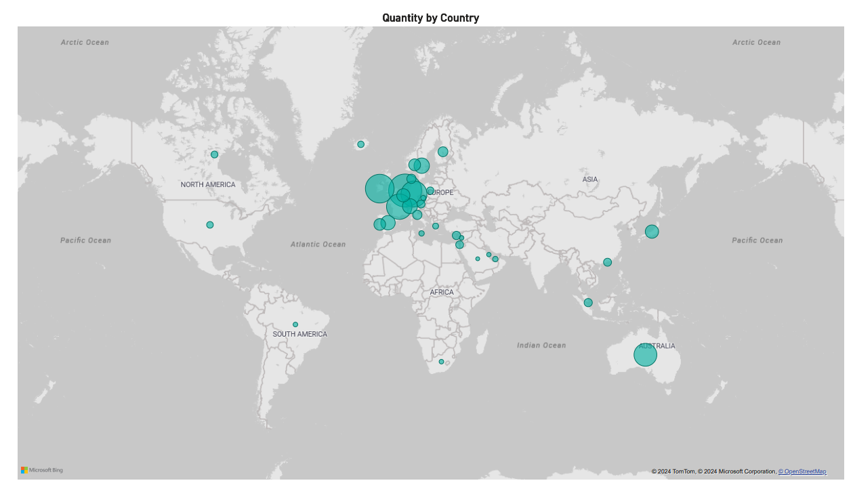
Geographic Distribution of Quantity Sold
The map visualization shows the distribution of quantity by country, highlighting global activity with significant concentrations in specific regions. Europe stands out as the primary hub of activity, evidenced by multiple large circles indicating higher quantities. There is also notable activity in North America, particularly in Canada, as well as in South America, Africa, and parts of Asia. Australia also shows a significant amount of activity, comparable to some European countries. The distribution suggests a wide-reaching global presence, with Europe and Australia being the most prominent regions of activity.

Slide 11
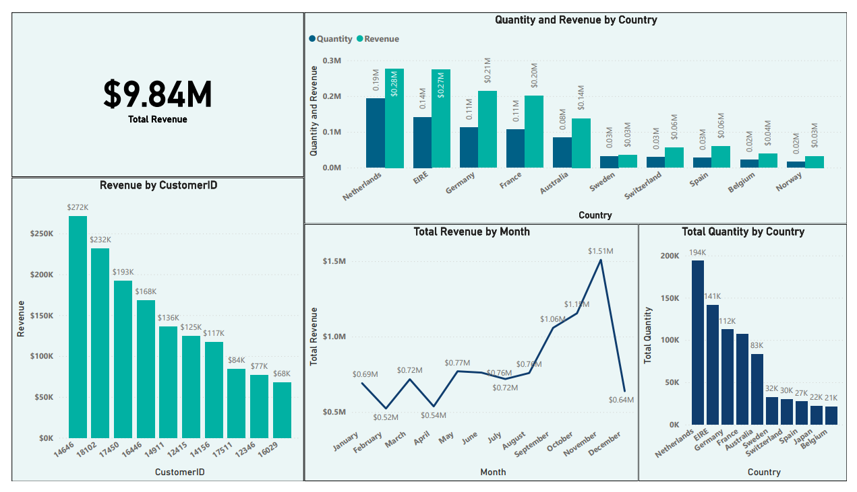

Slide 12

Implications
Monthly Revenue: The revenue trends suggest significant seasonal fluctuations, with a peak from September to November. Focusing on maximizing revenue during these peak months while smoothing out the declines in February, April, and December could enhance overall performance. Strategic planning around these periods is crucial for optimizing inventory, marketing, and resource allocation.
Quantity and Revenue by Country: Marketing and sales efforts should be concentrated on top-performing countries to maximize market potential. Exploring premium product offerings in high-revenue but lower-quantity countries like EIRE can further enhance profitability. Developing strategies to increase sales volume in countries like Switzerland and Spain, which show good revenue despite lower quantities, can also be beneficial. These insights should guide international expansion and marketing strategies to enhance market presence and profitability.
Top Customers by Revenue: To maximize revenue, the company should prioritize maintaining relationships with these high-revenue customers through loyalty programs and personalized offers. Engaging these customers for feedback can provide valuable insights to improve products and services. Furthermore, understanding their purchasing behavior can inform targeted marketing strategies to boost sales further.
Geographical Distribution of Quantity Sold: The strong presence in Europe and Australia indicates high market penetration in these regions. Maintaining and strengthening this presence, while also targeting growth in underperforming regions like North America, South America, Africa, and Asia, could balance the company's global footprint and enhance market share. Targeted marketing and resource distribution in these areas could yield significant benefits.

Slide 13
Thank you
Any Further Questions ?

Slide 14


